Slide 1








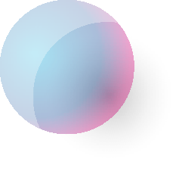










Tahaluf Copyright 2022- All Right Reserved
Harmony IT Solution
learning Hub
Angular
Tahaluf Training Center 2022

Slide 2



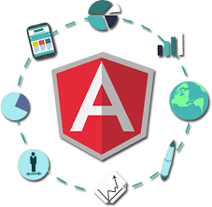





Tahaluf Copyright 2022- All Right Reserved
Harmony IT Solution
1
What is Angular?
2
Advantages of Angular.
3
Angular Versions.
4
Single-Page Application.
5
5
Create Angular Project.
6
6
Flow of Execution of Angular App.
7
7
Component in Angular.
8
Generate a new component.
8
8
9

Slide 3










Tahaluf Copyright 2022- All Right Reserved
Harmony IT Solution
Objective

Slide 4
Tahaluf Copyright 2022- All Right Reserved
Harmony IT Solution
The Objective of this lecture
Find out what Angular is in all versions.
Distinguish between the concept of a single-page application and a multi-page application.
Download the Angular package and create your first project with Angular.
Understanding the component and how to create it using the terminal.

Slide 5
Tahaluf Copyright 2022- All Right Reserved
Harmony IT Solution
What is Angular?

Slide 6
Tahaluf Copyright 2022- All Right Reserved
Harmony IT Solution
Overview of Angular
Angular is a development platform for building Single Page Applications.
It uses Typescript & HTML to build Apps.
The Angular itself is written using Typescript.
It now comes with every feature you need to build a complex web or mobile application.

Slide 7
Tahaluf Copyright 2022- All Right Reserved
Harmony IT Solution
Overview of Angular
It comes with features like Component, Directives, Forms, Pipes, HTTP Services, Dependency Injection, etc.
Angular website:
https://angular.io/

Slide 8
Tahaluf Copyright 2022- All Right Reserved
Harmony IT Solution
Advantages of Angular

Slide 9
Tahaluf Copyright 2022- All Right Reserved
Harmony IT Solution
1. Comprehensive:
The angular framework is a full-featured framework that provides out-of-the-box solutions for server communication, routing, and more.
2. Browser Compatibility:
Angular is cross-platform and compatible with multiple browsers.
3. Testing:
Testing is a first-class tool, and Angular was built to be testable from the beginning.

Slide 10
Tahaluf Copyright 2022- All Right Reserved
Harmony IT Solution
4. Custom Components:
Angular allows users to build their own components that can pack functionality along with rendering logic into reusable pieces.
5. Data Binding:
Angular allows users to effortlessly move data from JavaScript/TypeScript code to the view and react to user events without having to write any code manually.
6. Dependency Injection:
Allows users to write modular services and inject them wherever they are needed.

Slide 11
Tahaluf Copyright 2022- All Right Reserved
Harmony IT Solution
Angular Versions

Slide 12
Tahaluf Copyright 2022- All Right Reserved
Harmony IT Solution
The early version of Angular was named AngularJS.
Then later it was renamed just Angular. Angular Versions:
AngularJS 1. X
Angular 2
Angular 3
Angular 4
Angular 5
Angular 6
Angular 7

Slide 13
Tahaluf Copyright 2022- All Right Reserved
Harmony IT Solution
Angular Versions:
Angular 8
Angular 9
Angular 10
Angular 11
Angular 12
Angular 13
Angular is constantly growing with better features and faster performance.

Slide 14
Tahaluf Copyright 2022- All Right Reserved
Harmony IT Solution
Single-Page Application

Slide 15
Tahaluf Copyright 2022- All Right Reserved
Harmony IT Solution
Single-Page Application
Multi-Page Application
VS.

Slide 16
Tahaluf Copyright 2022- All Right Reserved
Harmony IT Solution
Multi-Page Applications
Multi-Page Applications (MPA) were traditionally used, where every time you clicked on a link, a new page was loaded from the server. Additionally, it was time-consuming and increased server load, which slowed the website.

Slide 17
Tahaluf Copyright 2022- All Right Reserved
Harmony IT Solution
Single Page Applications
The concept of a single page application refers to a web application that loads a single HTML page and only a part of the page gets updated on each mouse click rather than the entire page. There is no reloading of the page or transfer of control to another page during the process. The result is high performance and faster loading pages.

Slide 18
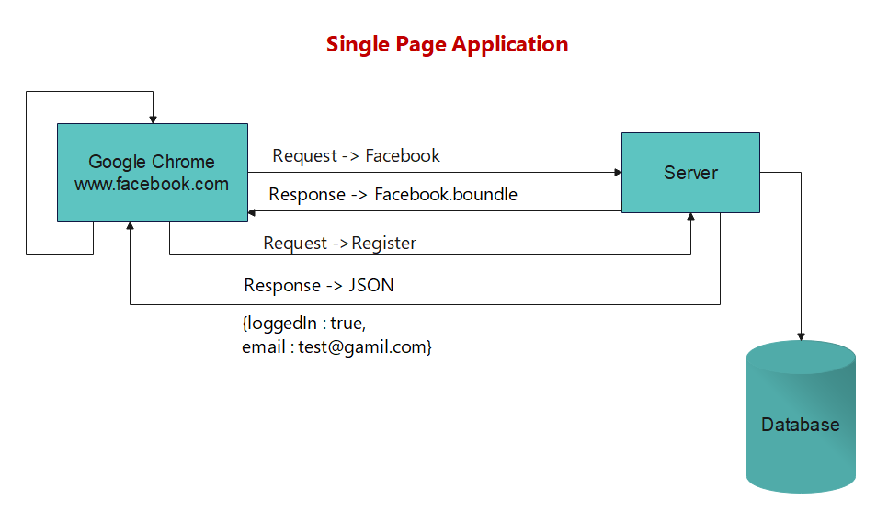
Tahaluf Copyright 2022- All Right Reserved
Harmony IT Solution

Slide 19



Tahaluf Copyright 2022- All Right Reserved
Harmony IT Solution
Single Page Applications Example
Twitter
Git Hub
PayPal

Slide 20
Tahaluf Copyright 2022- All Right Reserved
Harmony IT Solution
Create Angular Project

Slide 21
Tahaluf Copyright 2022- All Right Reserved
Harmony IT Solution
Create Angular Project
First, install the angular package (@angular/cli): npm i -g @angular/cli
Read more about the angular package:
https://www.npmjs.com/package/@angular/cli

Slide 22

Tahaluf Copyright 2022- All Right Reserved
Harmony IT Solution
Create Angular Project
To create the angular project, use this command:
ng new project_name

Slide 23
Tahaluf Copyright 2022- All Right Reserved
Harmony IT Solution
Create Angular Project
We will create an LMS website (EduTech) during this course, to create the angular project for our demo, use this command:
ng new EduTech

Slide 24
Tahaluf Copyright 2022- All Right Reserved
Harmony IT Solution
Create Angular Project
To run the project, use this command:
ng serve -o

Slide 25
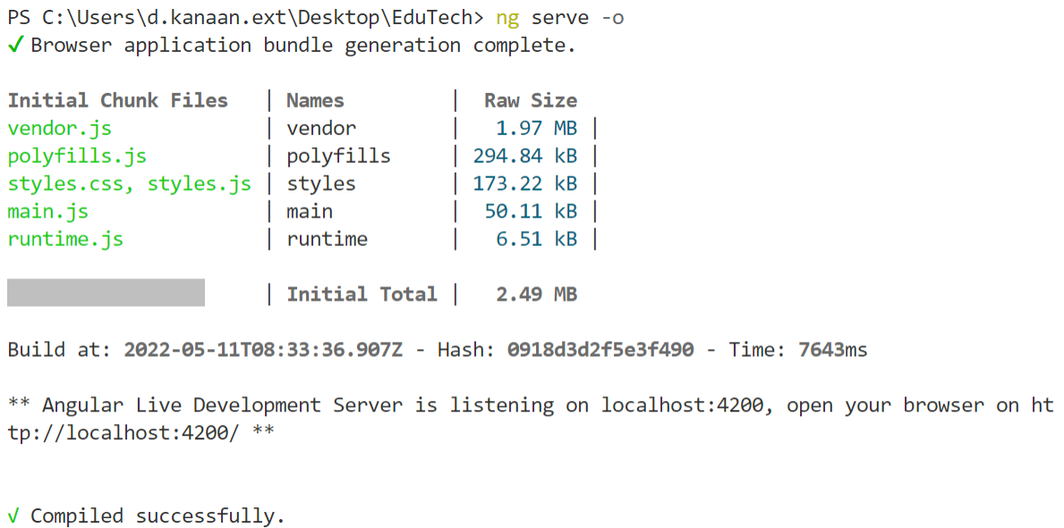
Tahaluf Copyright 2022- All Right Reserved
Harmony IT Solution
Note :
By default, angular project run on port 4200.

Slide 26
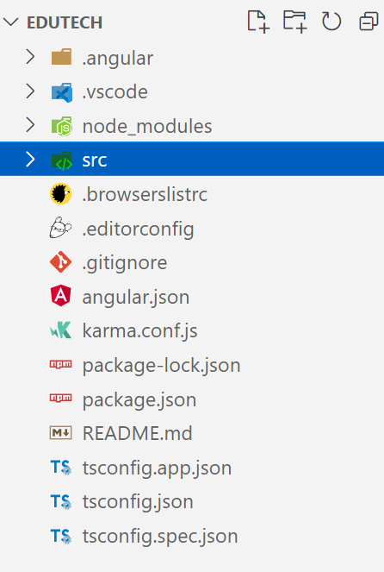
Tahaluf Copyright 2022- All Right Reserved
Harmony IT Solution
EduTech project files:

Slide 27
Tahaluf Copyright 2022- All Right Reserved
Harmony IT Solution
Angular project files
node_modules: You can think of the node_modules folder as a cache for the external modules that your project depends upon. NPM installs these modules with the NPM service, which downloads them from the web and copies them into the node_modules folder.
src: The project will be worked on in this folder.
Inside the src, the app folder was created during the project setup and holds all the required files for the project.

Slide 28
Tahaluf Copyright 2022- All Right Reserved
Harmony IT Solution
Angular project files
assets: It contains the resources such as images, videos, audio, and bootstrap files.
index.html: It is the first file that will be loaded in the angular project.
styles.css: It contains the CSS style that you would apply to the whole project.

Slide 29
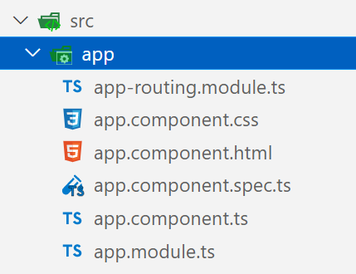
Tahaluf Copyright 2022- All Right Reserved
Harmony IT Solution
Angular project files
By default, angular project contains one component called app component.

Slide 30
Tahaluf Copyright 2022- All Right Reserved
Harmony IT Solution
Flow of Execution of Angular App.

Slide 31
Tahaluf Copyright 2022- All Right Reserved
Harmony IT Solution
main.ts
app.module.ts
app.component.ts
+
app.component.html

Slide 32


















The Learning Hub Copyright 2022- All Right Reserved
Break
4:08 - 4:20
Notes:
Break slide

Slide 33
Tahaluf Copyright 2022- All Right Reserved
Harmony IT Solution
Component in Angular

Slide 34
Tahaluf Copyright 2022- All Right Reserved
Harmony IT Solution
Overview of Angular Component
Components are the basic building blocks of an Angular application.
The Component defines the View and its data, which determine how the View appears and behaves.
Components in Angular are JavaScript/TypeScript classes that are defined using @component Decorators.
Using the Decorator, the component can display a View & get metadata about the class.

Slide 35
Tahaluf Copyright 2022- All Right Reserved
Harmony IT Solution
Overview of Angular Component
Data Binding is the process used by the component to pass data to the view.
The DOM elements are bound to the component properties through DOM Binding.
Component class bindings are used to display the value of component class properties, change element styles, and respond to user events.

Slide 36
Tahaluf Copyright 2022- All Right Reserved
Harmony IT Solution
Generate a new component

Slide 37
Tahaluf Copyright 2022- All Right Reserved
Harmony IT Solution
How to generate a new component
To add a new component, use this command:
ng generate component component_name
or ng g c component_name

Slide 38
Tahaluf Copyright 2022- All Right Reserved
Harmony IT Solution
By default, this generates four files:
componentName.component.css
componentName.component.html
componentName.component.spec.ts
componentName.component.ts
The spec files are unit tests for your source files.
To skip the spec file:
ng g c --skip-tests=true component_name

Slide 39
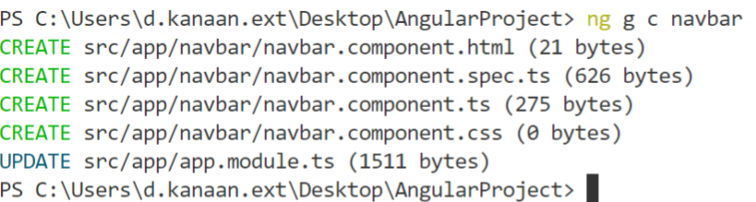
Tahaluf Copyright 2022- All Right Reserved
Harmony IT Solution
Example of generating a new component

Slide 40
Tahaluf Copyright 2022- All Right Reserved
Harmony IT Solution
Example of generating a new component
Use this link to add the navbar from our template:
https://designhooks.com/freebies/free-education-website-html-template-2/

Slide 41
Tahaluf Copyright 2022- All Right Reserved
Harmony IT Solution
The Output :

Slide 42

Tahaluf Copyright 2022- All Right Reserved
Harmony IT Solution
Exercises
Generate a new component called a footer and write the copyright statement with the current year ex. Copyright @2022 EdTech and do the style for it.

Slide 43
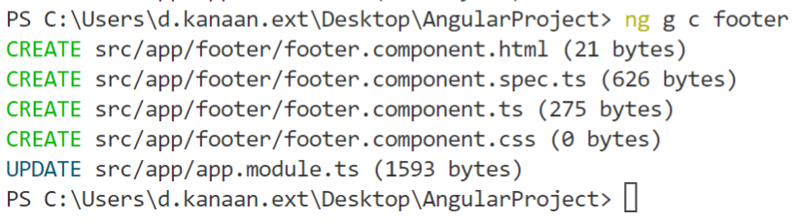

Tahaluf Copyright 2022- All Right Reserved
Harmony IT Solution
Exercise Solution :

Slide 44
Tahaluf Copyright 2022- All Right Reserved
Harmony IT Solution
Exercise Solution :
Use this link to add the footer from our template:
https://designhooks.com/freebies/free-education-website-html-template-2/

Slide 45
Tahaluf Copyright 2022- All Right Reserved
Harmony IT Solution
Exercise Solution :
In TypeScript file:
export class FooterComponent implements OnInit {
year : number | undefined = new Date().getFullYear()
}

Slide 46
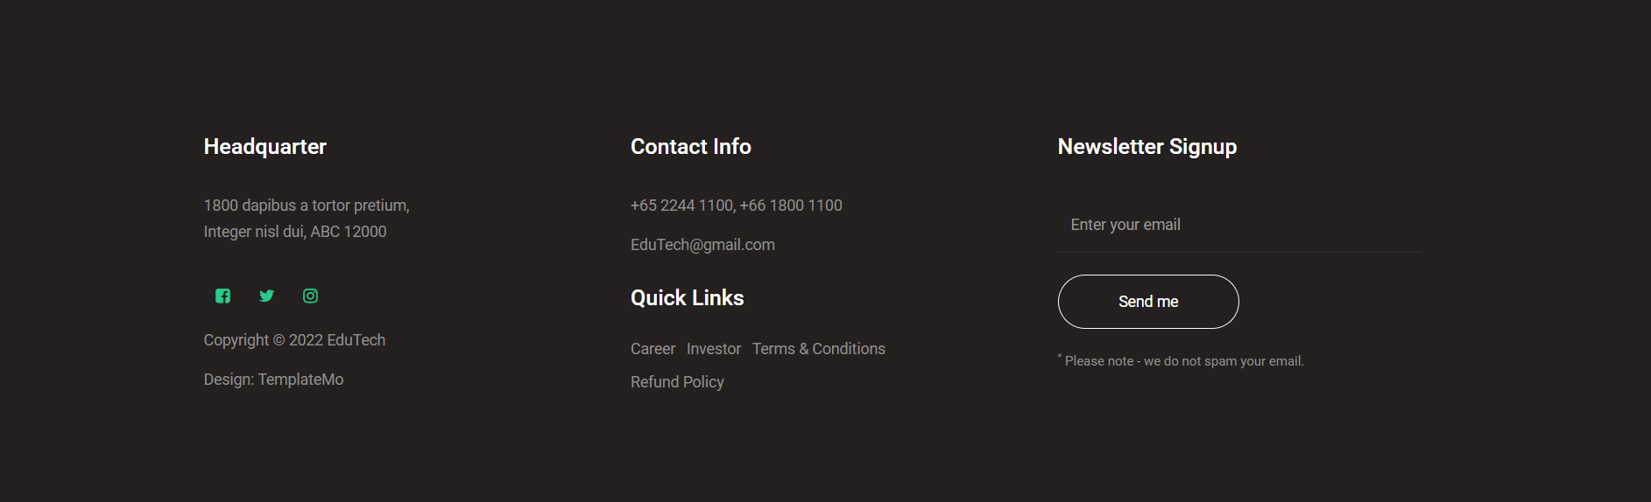
Tahaluf Copyright 2022- All Right Reserved
Harmony IT Solution
The Output:

Slide 47
Tahaluf Copyright 2022- All Right Reserved
Harmony IT Solution
References
[1] Angular, “Angular,” Angular.io, 2019. https://angular.io/
[2] “Complete Angular Tutorial For Beginners,” TekTutorialsHub. https://www.tektutorialshub.com/angular-tutorial/
[3]“npm | build amazing things,” Npmjs.com, 2019. https://www.npmjs.com/
[4]“Angular Tutorial for Beginners | Simplilearn,” Simplilearn.com. https://www.simplilearn.com/tutorials/angular-tutorial (accessed Aug. 19, 2022).
Overview of Database

Slide 48








Tahaluf Copyright 2022- All Right Reserved
Harmony IT Solution
Thank youﻂﺤﻧ
Any Question?

